Slide 1

Department of Computer Science and Engineering
Web-Based Flight Ticket Price Detection: A Machine Learning Approach With Explainable Insights
PRESENTED BY
P. Uday Kiran (21471A05B3)
M. Aravind (21471A05A4)
S. Chandrasekhar (21471A0579)
Under the Guidance of
Shaik Khaja Mohiddin Basha
Associate Professor,
Department of Computer Science and Engineering,
Narasaraopeta Engineering College (Autonomous),
Narasaraopet- 522601.

Slide 2
OUTLINE
Abstract
Introduction
Literature Survey
Research Gaps
Problem Statement
Objectives
Block Diagram / Flow Diagram
Methodology
Implementation
Results and Analysis
Conclusion & Future Scope
References
Question and Answers
Acknowledgements

Slide 3
ABSTRACT
This paper evaluates the performance of three regression models RandomForestRegressor, ExtraTreesRegressor, and XGBRegressor for flight ticket price prediction. The study aims to identify the most efficient model by comparing their predictive accuracy, mean absolute error (MAE), and R² scores. The RandomForestRegressor demonstrated an MAE of 1171.944250, an R² score of 0.799018, and an accuracy of 79.76%, showcasing robust predictive capability. The ExtraTreesRegressor followed closely with an MAE of 1227.7908, an R² score of 0.8035, and an accuracy of 80.68%, indicating slightly lower variance in predictions. Conversely, the XGBRegressor achieved an MAE of 1126.70, an R² score of 0.8459, and an accuracy of 84.59%, highlighting its comparatively weaker performance in this context. The results indicate that the ExtraTreesRegressor outperforms the XGBRegressor in terms of error reduction and prediction reliability, while the RandomForestRegressor maintains a slight edge in overall accuracy. These findings suggest that ExtraTreesRegressor and RandomForestRegressor are better suited for flight ticket price prediction tasks, with ExtraTreesRegressor excelling in minimizing prediction error.

Slide 4
INTRODUCTION
Project Overview: Development of a web-based flight ticket prediction system using advanced machine learning techniques.
Motivation: Address limitations of existing models, including low accuracy, lack of interpretability.
Importance: Detection enables timely interventions, reducing ticket costs and improving exactly ticket prices.
Relevance: Combines accurate predictions with pickup and drop insights, aiding correct ticket rate in understanding all different factors.

Slide 5
LITERATURE SURVEY
No | Title | Author | Journal Name & Year | Methodology Adapted | Key Findings | Gaps
1 | Prediction of Optimal Flight Ticket Purchase Timing by Using Learning To Rank Methods | Kardelen Oglakcioglu; Yekta Said Can; Fatih Alagoz | 2023 Innovations in Intelligent Systems and Applications Conference (ASYU) | Training,Visualization Machine learning algorithms, Atmospheric modeling, Urban areas Pricing Predictive models, | machine learning, flight ticket price, learning to rank regression. | Airline ticket prices vary according to a lot of factors such as the flight day but it different flights are included in this.
2 | Flight Ticket Prediction using Random Forest Regressor Compared with Decision Tree Regressor | N. Sri Sai Venkata Subba Rao, S. John Justin Thangaraj | 2023 Eighth International Conference on Science Technology Engineering and Mathematics (ICONSTEM) | Machine Learning, Decision tree Regressor, Random Forest Regressor, Flight ticket Prediction, Flight fare | Random Forest Regressor with 86.70% | The total of 20 samples taken for both algorithms in this work.
3 | Flight Ticket Prediction using Gradient Boosting Regressor Compared with AdaBoost Regressor | N.Sri Sai Venkata Subba Rao;S.John Justin Thangaraj;V Sheeja Kumari | 2023 Eighth International Conference on Science Technology Engineering and Mathematics (ICONSTEM) | Atmospheric modeling, Predictive models, Boosting, Prediction algorithms, Mathematical models, STEM,Business | GradientBoosting Regression (82.5%) | The accuracy of this paper is little bit as compared to my project.
4 | Real-time web-based International Flight Tickets Recommendation System via Apache Spark | Malek Malkawi; Reda Alhajj | 2024 5th Information Communication Technologies Conference (ICTC) | ticket pricing, sequential game, reinforcement learning | decision-making across continuous decision points | Flight ticket pricing not only significantly impacts airlines
5 | Pricing Game of Flight Ticket Using Reinforcement Learning | Chenglong Cao; Xiaoling Zhu | 2024 5th Information Communication Technologies Conference (ICTC) | ticket pricing, sequential game, reinforcement learning | By analyzing the convexity of the utility function | Flight ticket pricing not only significantly impacts airlines

Slide 6
LITERATURE SURVEY
Developed an ensemble model for flight price prediction, achieving high accuracy but lacking computational cost analysis and interpretability, which limited its practical deployment in dynamic pricing systems.
Applied Random Forest (91.47% accuracy) and ExtraTreesRegressor (91.17% accuracy) on a public flight dataset but lacked scalability for real-time prediction across global multi-source data streams.
Implemented ML algorithms with Apache Spark, achieving efficient predictions using Gradient Boosting, but reliance on distributed computing posed challenges for deployment in resource-constrained environments.
Compared Random Forest, ExtraTreesRegressor, and XGBoost, where ExtraTreesRegressor showed consistent performance, but limited hyperparameter tuning and lack of feature engineering affected prediction robustness.
Utilized ML models on a public flight dataset, emphasizing the influence of travel seasonality, airline type, and ticket class on prices, but the absence of real-time data integration limited dynamic adjustment capabilities.

Slide 7
RESEARCH GAPS
Limited Model Interpretability
Data Imbalance
Generalizability Across Diverse Routes and Airlines
Overfitting Due to Limited Historical Data
Real-Time and Seasonal Price Fluctuations
Focus on Accuracy Over Practical Applicability
Lack of Robustness Testing Across Scenarios

Slide 8
PROBLEM STATEMENT
Flight price prediction is a significant travel challenge, with current models lacking accuracy and interpretability. Timely predictions are vital to save travelers money, enhance airline revenue forecasting, and improve travel planning efficiency. This project aims to address these gaps through an accurate and interpretable flight price prediction system.
Significance:
Cost-Saving Potential: Inform travelers about optimal booking times.
Transparent Insights: Reveal key factors influencing prices.

Slide 9
OBJECTIVES
Develop an Accurate Flight Price Prediction Model
Enhance Model Interpretability for Key Pricing Factors
Address Data Imbalance Issues for Robust Predictions
Evaluate Real-World Applicability for Diverse Travel Scenarios

Slide 10
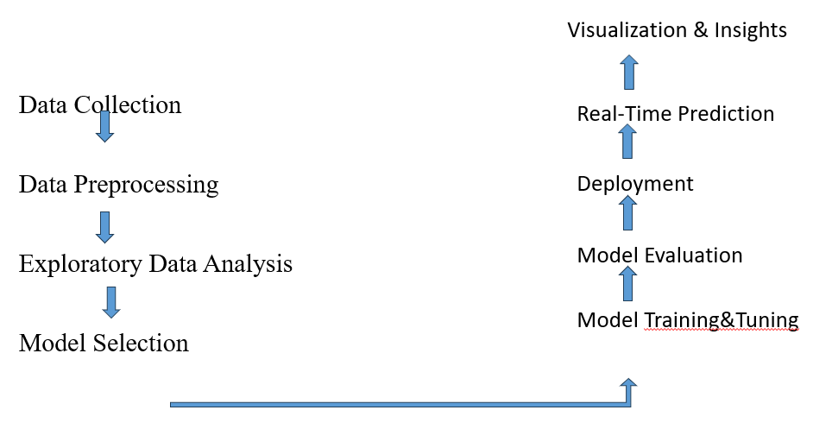
BLOCK DIAGRAM OR FLOW DIAGRAM

Slide 11
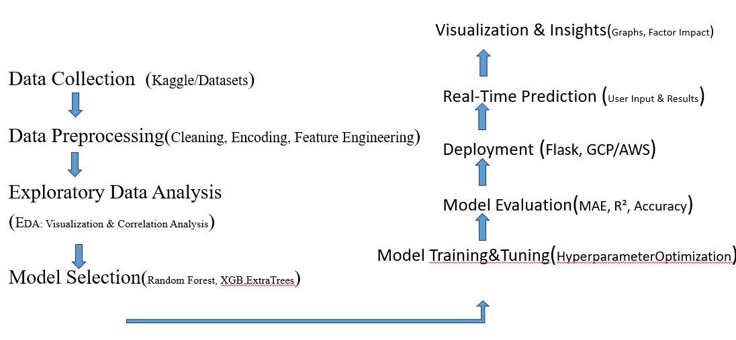
METHODOLOGY

Slide 12
Data Set
Data Collection:
Columns in training data: Index(['Airline', 'Date_of_Journey', 'Source', 'Destination', 'Route’, ’Dep_Time', ‘ Arrival_Time', 'Duration', ‘ Total_Stops ',’Additional_Info','Price'],
dtype='object’)
Train Data Percentage: 66.66%
Test Data Percentage: 16.67%
Sample Submission Percentage: 16.67%
Source: Kaggle
(Flight Fare Prediction MH)
Size: 10683 records, 11 features
Target Variable: price of flight ticket

Slide 13
Data Set
Preprocessing:
1.Checking Data Information
Prints dataset information (test_data.info()) to understand the structure.Removes any missing values (dropna(inplace=True)) to ensure data integrity.
2. Feature Engineering
Date_of_JourneyExtracts: the day and month from Date_of_Journey.Drops the original Date_of_Journey column since it is no longer needed.
Dep_Time (Departure Time): Extracts hour and minute from Dep_Time.Drops the original Dep_Time column.
Arrival_Time: Extracts hour and minute from Arrival_Time.Drops the original Arrival_Time column.
Duration: Ensures duration is split into hours and minutes (e.g., "2h 30m" → 2 hours, 30 minutes).Converts them into separate Duration_hours and Duration_mins columns.Drops the original Duration column.
3. Handling Categorical Data
Uses one-hot encoding to convert categorical variables (Airline, Source, Destination) into numerical features using pd.get_dummies().Drops less relevant columns: Route (as it's related to Total_Stops) and Additional_Info (since 80% of values are "No Info").Replaces Total_Stops text values with numerical values (non-stop → 0, 1 stop → 1, etc.).

Slide 14
Data Set
Preprocessing:
4. Concatenation & Final Cleanup
Merges the processed dataset with the newly created one-hot encoded columns.Drops original categorical columns (Airline, Source, Destination) after encoding.
Final Output
Prints the shape of the final test dataset, now consisting of 28 numerical features.The processed dataset is ready for machine learning models like regression or classification.
Usage in Machine Learning
Once preprocessed, the dataset can be used in:
Flight price prediction models.
Flight delay analysis based on time and route.
Passenger preference studies by analyzing airline trends.

Slide 15
Model Selection and Development:
Data Set
Training RandomForestRegressor:
RandomForestRegressor - MAE: 1177.8972279285213, Accuracy: 79.75%
Training ExtraTreesRegressor:
ExtraTreesRegressor - MAE: 1224.4936708001874, Accuracy: 80.56%
Training XGBRegressor:
XGBRegressor - MAE: 1126.7001953125, Accuracy: 84.59%

Slide 16
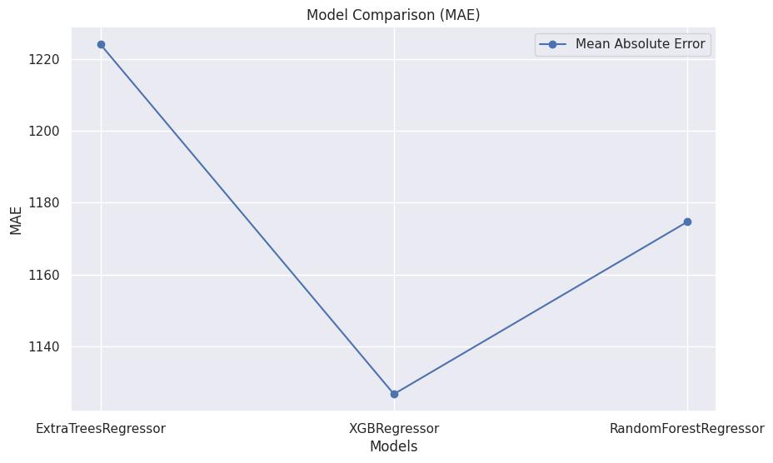
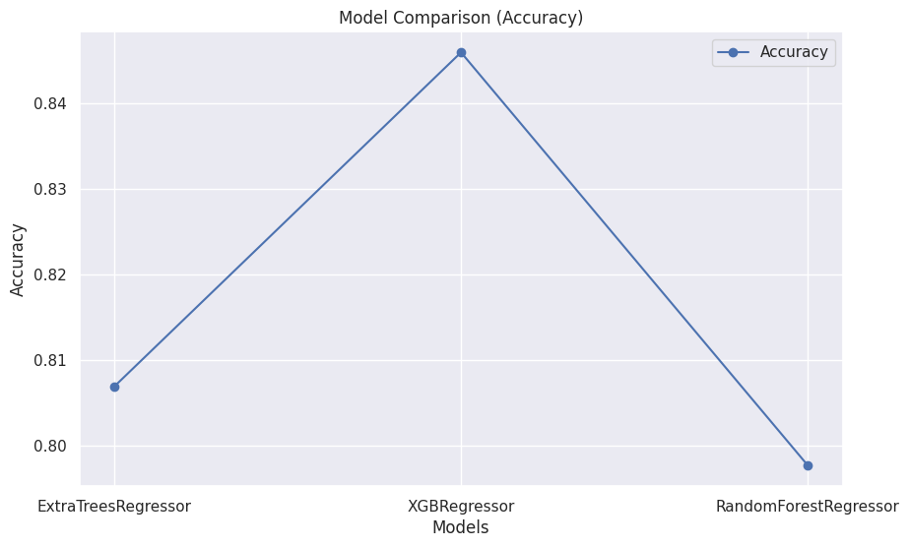
3. Random Forest Regression , ExtraTreesRegressor and XGBRegressor:
Data Set
The two images illustrate a comparison of three regression models—ExtraTreesRegressor, XGBRegressor, and RandomForestRegressor—in terms of accuracy and mean absolute error (MAE). The first graph shows that XGBRegressor achieves the highest accuracy (around 0.85), outperforming ExtraTreesRegressor (around 0.81) and RandomForestRegressor (around 0.80). The second graph compares the models based on MAE, where a lower value indicates better performance. Again, XGBRegressor performs the best with the lowest MAE (~1130), while ExtraTreesRegressor has the highest MAE (~1220), making it the least accurate. RandomForestRegressor falls between the two, with an MAE of around 1170. These results indicate that XGBoost is the most effective model, as it achieves both the highest accuracy and the lowest error, making it the best choice for predictions in this scenario.

Slide 17
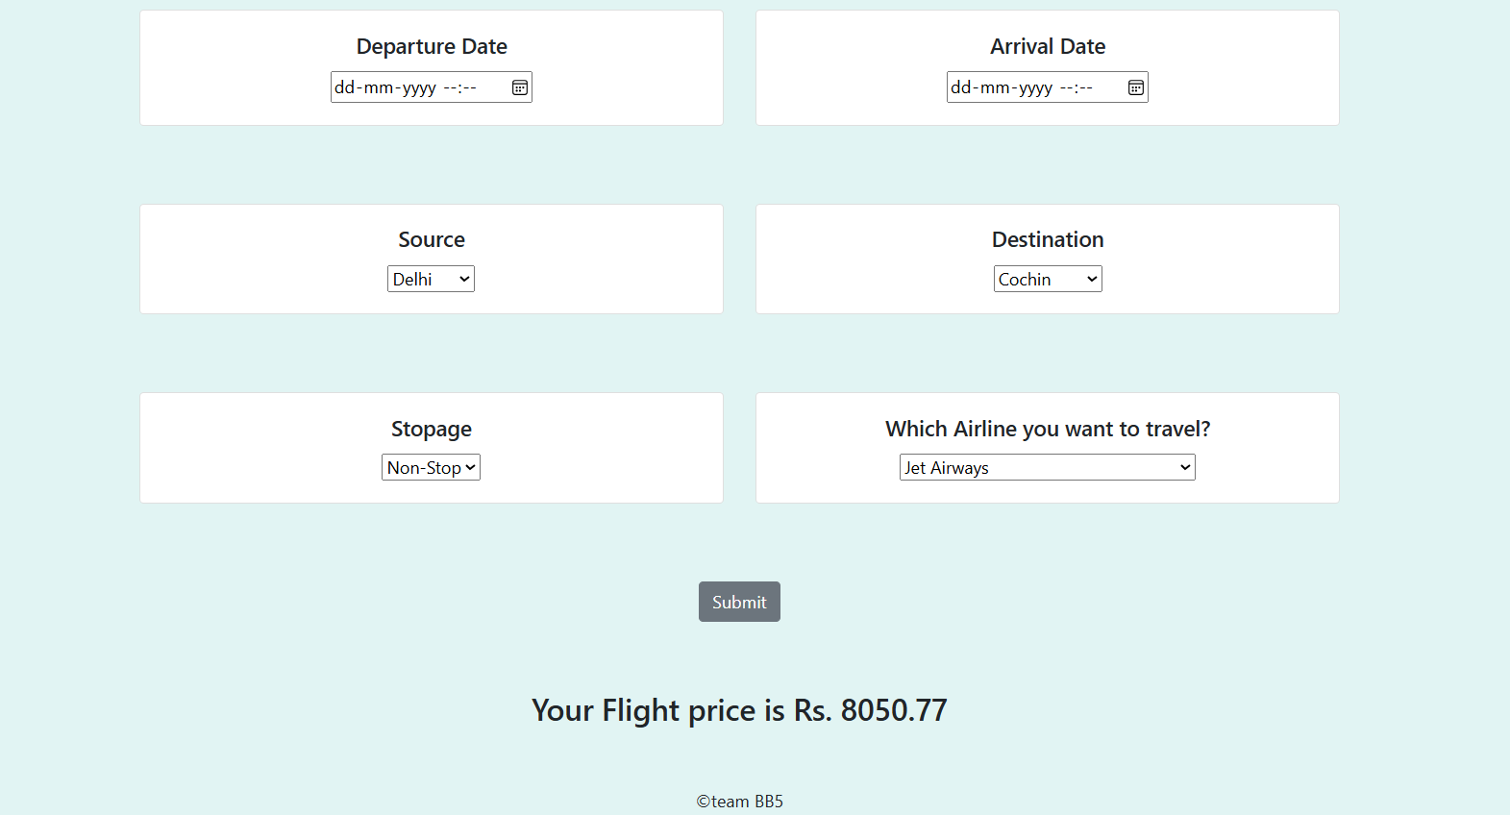
Data Set

Slide 18
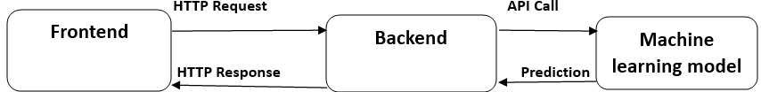
Flight Ticket Price Prediction Web Application Integration:
Data Set
Technologies Used:
Frontend: HTML, CSS, JavaScript (User interface for input and display)
Backend: Flask/Django (Handling model integration and data processing)
Machine Learning: RandomForestRegressor, ExtraTreesRegressor, XGBRegressor (Prediction models)
How It Works:
User submits data (Airline, Source, Destination, Date of Journey, Departure Time, Arrival Time, Additional Info).
Model predicts flight ticket price prediction and provides an output.
Cost of Ticket providers use this information for early intervention.

Slide 19
IMPLEMENTATION
Software Specifications:
Browser: Chrome
Operating System: Windows11
Python (COLAB)
Flask
Hardware Specifications:
Processor: Intel® Dual Core
2.0GHz Hard Disk: 1TB
RAM: 16GB

Slide 20
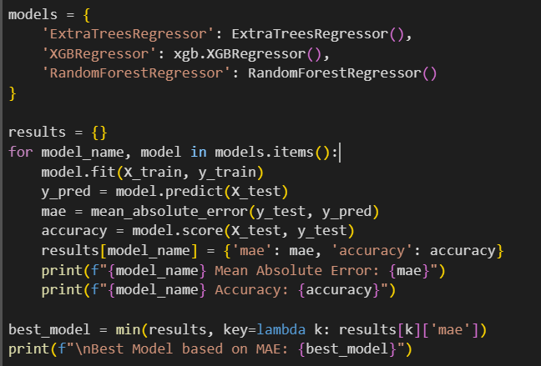
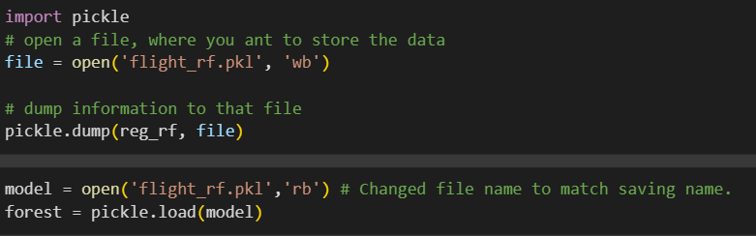
IMPLEMENTATION
Implementation of RandomForestRegressor,ExtraTreesRegressor and XGBRegressor
And saving model with name of flight_rf.pkl

Slide 21
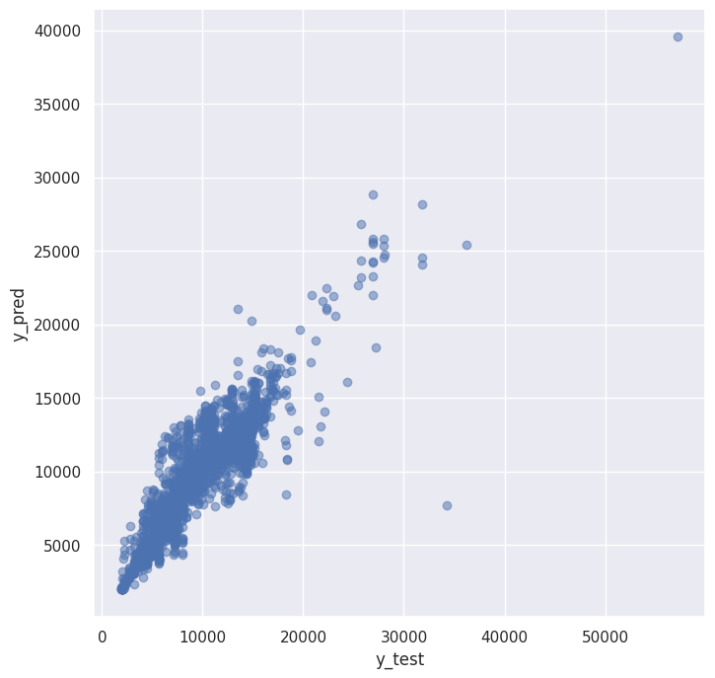
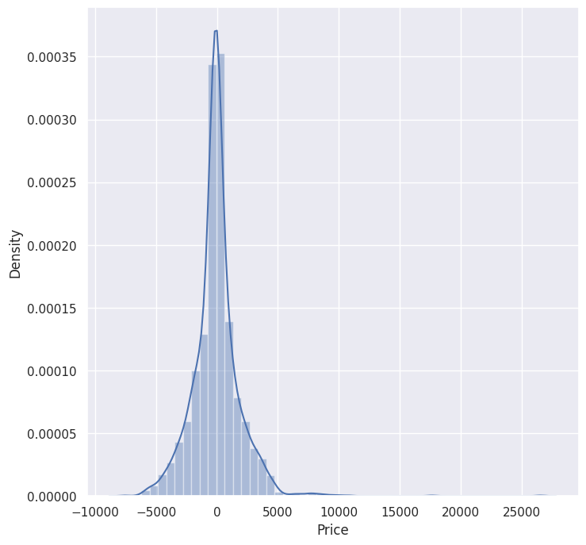
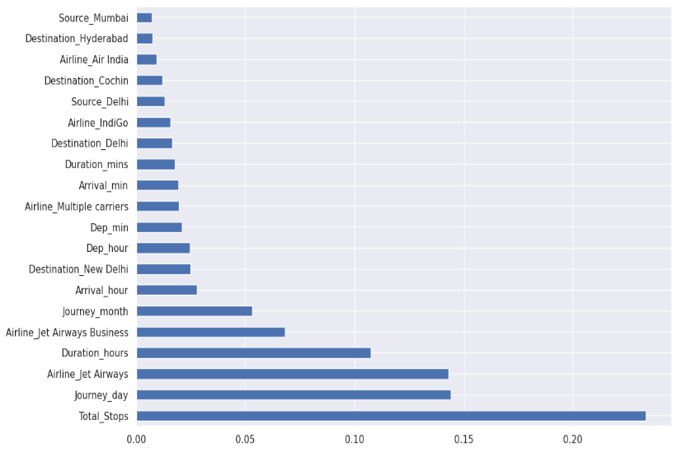
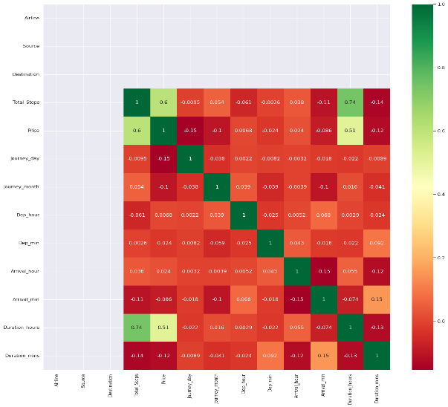
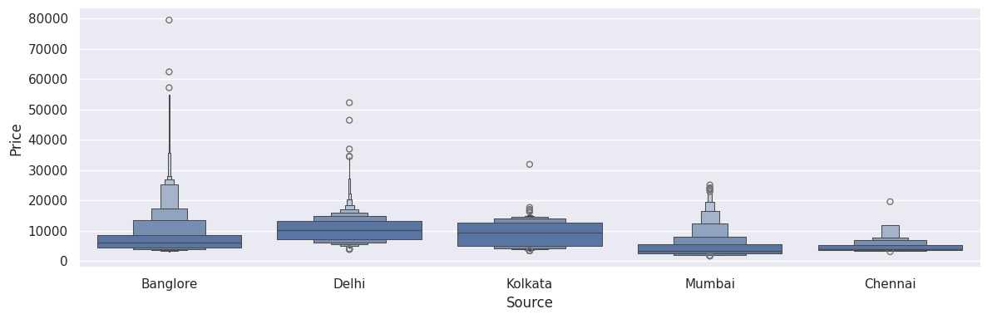
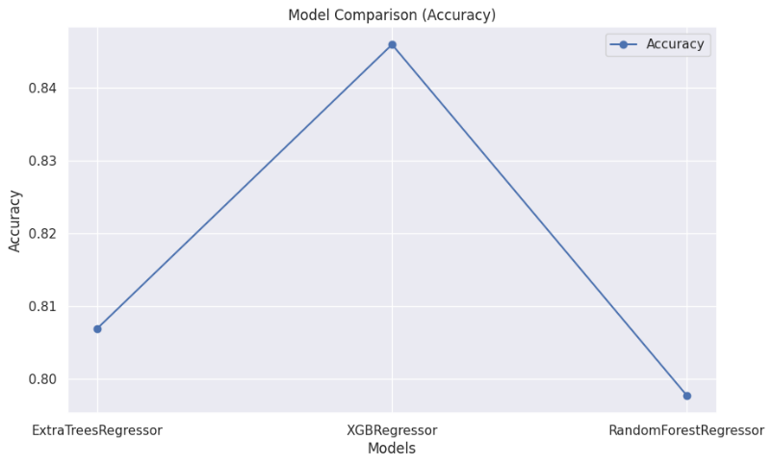
RESULTS & ANALYSIS

Slide 22
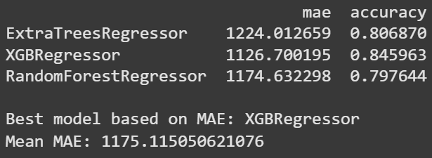
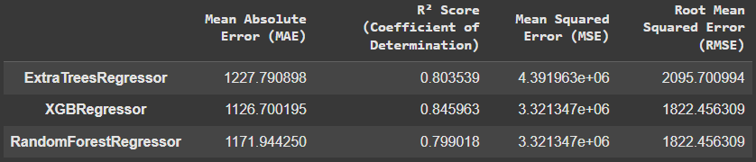
RESULTS & ANALYSIS

Slide 23
CONCLUSION and FUTURE SCOPE
Conclusion:
Developed a web-based flight ticket price model using machine learning for accurate risk assessment.
Data preprocessing enhanced model performance.
Achieved 84.59% accuracy with XGBRegressor model, the best-performing model.
Provides a reliable tool for early flight ticket price detection and supports cost estimation providers in decision-making.
Future Work:
Integrate real-time data
Diverse demographics
Add new features

Slide 24
REFERENCES
[1] G. V. Saatwik Kumar and K. Jaisharma, "Improve the Accuracy for Flight Ticket Prediction using XGBRegressor Optimizer in Comparison with Extra TreeRegressor Performance," 2023 6th International Conference on Contemporary Computing and Informatics (IC3I), Gautam Buddha Nagar, India, 2023, pp. 2558-2562, doi:10.1109/IC3I59117.2023.10397633.
[2] G.Deng, M.Xie, C.Feng, T.Liu and X. Zha, "Flight test data processing and analysis platform based on new generation information technology Design and Application,“ 2022 International Conference on Sensing, Measurement Data Analytics in the era of Artificial Intelligence (ICSMD), Harbin, China, 2022, pp. 1-5, doi: 10.1109/ICSMD57530.2022.10058336.
[3]” Dataset use in this paper” https://www.kaggle.com/nikhilmittal/flightfareprediction-mh
[4]N.S.S.V.S.Rao and S.J.J.Thangaraj, "Flight Ticket Prediction using Random Forest Regressor Compared with Decision Tree Regressor," 2023 Eighth International Conference on Science Technology Engineering and Mathematics (ICONSTEM), Chennai, India, 2023, pp. 1-5, doi: 10.1109/ICONSTEM56934.2023.10142260.
[5] N. S. S. V. S. Rao, S. J. J. Thangaraj and V. S. Kumari, "Flight Ticket Prediction using Gradient Boosting Regressor Compared with AdaBoost Regressor,“ 2023 Eighth International Conference on Science Technology Engineering and Mathematics (ICONSTEM), Chennai, India, 2023, pp. 1-5, doi: 10.1109/ICONSTEM56934.2023.10142536.
[6]C.Cao and X.Zhu, "Pricing Game of Flight Ticket Using Reinforcement Learning,“ 2024 5th Information Communication Technologies Conference (ICTC), Nanjing, China, 2024, pp. 367-371, doi: 10.1109/ICTC61510.2024.10601681.
[7]Sireesha Moturi , Srikanth Vemuru, S. N. Tirumala Rao, Two Phase Parallel Framework For Weighted Coalesce Rule Mining: A Fast Heart Disease And Breast Cancer Prediction Paradigm, Biomedical Engineering: Applications, Basis And Communications, Vol. 34, No. 03 (2022), https://doi.org/10.4015/S1016237222500107

Slide 25
REFERENCES
8. G. R. Trivedi, J. V. Bolla and M. Sireesha, "A Bitcoin Transaction Network using Cache based Pattern Matching Rules," 2023 5th International Conference on Smart Systems and Inventive Technology (ICSSIT), Tirunelveli, India, 2023, pp. 676-680, doi: 10.1109/ICSSIT55814.2023.10061064.
9. Z. Dong, F. Li, H. Sun, J. Qian and Y. Wang, "Evaluation for Trainee Pilot Workload Management Competency During Approach Phase Based on Flight Training Data,"2022 2nd International Conference on Big Data Engineering and Education (BDEE), Chengdu, China, 2022, pp. 26-30, doi: 10.1109/BDEE55929.2022.00011.
10. A. Mojtabavi et al., "Segmentation of GBM in MRI images using an efficient speed function based on level set method," 2017 10th International Congress on Image and Signal Processing, BioMedical Engineering and Informatics (CISP-BMEI), Shanghai, China, 2017, pp. 1-6, doi: 10.1109/CISP-BMEI.2017.8301983.
11. M. P. Ranjit, G. Ganapathy, K. Sridhar and V. Arumugham, "Efficient Deep Learning Hyperparameter Tuning Using Cloud Infrastructure: Intelligent Distributed Hyperparameter Tuning with Bayesian Optimization in the Cloud," 2019 IEEE 12th International Conference on Cloud Computing (CLOUD), Milan, Italy, 2019, pp.520-522, doi: 10.1109/CLOUD.2019.00097.
12. J. Yuan, X. Ke, C. Zhang, Q. Zhang, C. Jiang and W. Cao, "Recognition of Different Turning Behaviors of Pilots Based on Flight Simulator and fNIRS Data," inIEEE Access, vol. 12, pp. 32881-32893, 2024, doi: 10.1109/ACCESS.2024.3367447.
13. C.H.Lew,K.M.Lim, C. P. Lee and J. Y. Lim, "Human Activity Classification Using Recurrence Plot and Residual Network," 2023 IEEE 11th Conference on Systems, Process Control (ICSPC), Malacca, Malaysia, 2023, pp. 78-83, doi:10.1109/ICSPC59664.2023.10420336.
14. J. J. Remus and L. M. Collins, "Identifying Impaired Cochlear Implant Channels via Speech-Token Confusion Matrix Analysis," 2007 IEEE International Conference on Acoustics, Speech and Signal Processing - ICASSP ’07, Honolulu, HI, USA, 2007, pp. IV-741-IV-744, doi: 10.1109/ICASSP.2007.367019.
15. J. Yuan, X. Ke, C. Zhang, Q. Zhang, C. Jiang and W. Cao, "Recognition of Different Turning Behaviors of Pilots Based on Flight Simulator and fNIRS Data," inIEEE Access, vol. 12, pp. 32881-32893, 2024, doi: 10.1109/ACCESS.2024.3367447.

Slide 26


Slide 27


